Slide 1
Unit III: Application Level Services

Slide 2
High Level Services
FTP.
• HTTP.
• S-HTTP is a superset of HTTP, which allows messages to be encapsulated for increased security. Encapsulations include encryption, signing and MAC-based authentication. An S-HTTP message can have several security transformations applied to it. S-HTTP also It is generally regarded as being superior to HTTPS, a pure SSL encryption.
• HTTPS.
• SSH. The secure shell. A replacement for the remote shell (rsh) Unix protocol. The secure shell provides full encryption and forwarding of X11 display data through a secure pipe.
• LDAP
• NTP is the Network Time Protocol, used for synchronizing clocks throughout the network.
• IMAP. Internet Mail Access Protocol provides a modern mailbox format and a number of network services for reading and transferring mail over the network.
• RPC

Slide 3
Proxies and Agents

Slide 4
Proxy Servers
Part of an overall Firewall strategy
Sits between the local network and the external network
  Originally used primarily as a caching strategy to minimize outgoing URL requests and increase perceived browser performance
  Primary mission is now to insure anonymity of internal users
    Still used for caching of frequently requested files
    Also used for content filtering
Acts as a go-between, submitting your requests to the external network
  Requests are translated from your IP address to the Proxy’s IP address
  E-mail addresses of internal users are removed from request headers
  Cause an actual break in the flow of communications

Slide 5
Security Advantages
Terminates the TCP connection before relaying to target host (in and out)
Hide internal clients from external network
Blocking of dangerous URLs
Filter dangerous content
Check consistency of retrieved content
Eliminate need for transport layer routing between networks
Single point of access, control and logging

Slide 6
TCP Connection Termination
Both the outgoing and incoming TCP connections are terminated
prevents a hacker from hijacking a stale connection on a service that is being proxied
ex . HTTP page request
request packet’
request packet
User
Proxy
Server
response packet
response packet’
Connection left open until the proxy closes it after receiving response packet and sending it back to user
Connection only left open until server closes the connection after sending the response packet

Slide 7
TCP Connection Termination
Transport layer packets don’t need to be routed because the entire request must be regenerated
  Prevents transport layer exploits
    source routing
    fragmentation
    several DoS attacks
Since some protocols don’t have proxies available many admins will enable routing , this alleviates any benefit gained
Most good proxy servers will allow you to create generic proxies using SOCKS or the redir utility

Slide 8
Performance Aspects
Caching
  By keeping local copies of frequently accessed file the proxy can serve those files back to a requesting browser without going to the external site each time, this dramatically improves the performance seen by the end user
  Only makes sense to implement this at the ISP rather than the small business level because of the number of pages available
  Because of dynamic content many pages are invalidated in the cache right away
Load balancing
  A proxy can be used in a reverse direction to balance the load amongst a set of identical servers (servers inside the firewall and users outside)
  Used especially with web dynamic content (.asp, .php,.cfm,.jsp)

Slide 9
Proxy Liabilities
Single point of failure
  if the proxy dies , no one can get to the external network
Client software must usually be designed to use a proxy
Proxies must exist for each service
Doesn’t protect the OS
  proxies run at the application level
Usually optimized for performance rather than security
  WINGATE was installed to be easy to configure; opened a winsock proxy to the external interface, which let hackers essentially hijack the machine
Create a service bottleneck
  solved via parallelism (more proxies, and load balance)

Slide 10
Transparent / Opaque
Transparent – both parties (local/remote) are unaware that the connection is being proxied
  Zorp - application layer proxy is transparent
Opaque – the local party must configure client software to use the proxy
  client software must be proxy-aware software
  Netscape proxy server is opaque
With all of the things modern firewalls can do in the area of redirection you could configure the firewall to redirect all http requests to a proxy
  no user configuration required (transparent)

Slide 11
Circuit Level Proxies
Since some protocols require a real connection between the client and server, a regular proxy can’t be used
  Windows Media Player, Internet Relay Chat (IRC), or Telnet
Circuit-level proxy servers were devised to simplify matters.
  Instead of operating at the Application layer, they work as a "shim" between the Application layer and the Transport layer, monitoring TCP handshaking between packets from trusted clients or servers to untrusted hosts, and vice versa. The proxy server is still an intermediary between the two parties, but this time it establishes a virtual circuit between them.
By using SOCKS (RFC 1928) this can be done
  SOCKS defines a cross-platform standard for accessing circuit-level proxies
  SOCKS Version 5 also supports both username/password (RFC 1929) and API-based (RFC 1961) authentication. It also supports both public and private key encryption.
  SOCKS 5 is capable of solving this problem by establishing TCP connections and then using these to relay UDP data.

Slide 12
SOCKS based Proxying
RFC 1928
Not a true application layer proxy
SOCKS protocol provides a framework for developing secure communications by easily integrating other security technologies
SOCKS includes two components
  SOCKS server
    implemented at the application layer
  SOCKS client
    implemented between the application and transport layers
The basic purpose of the protocol is to enable hosts on one side of a SOCKS server to gain access to hosts on the other side of a SOCKS Server, without requiring direct IP-reachability.
Copies packet payloads through the proxy

Slide 13
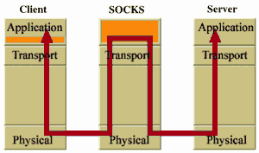
Socks Architecture

Slide 14
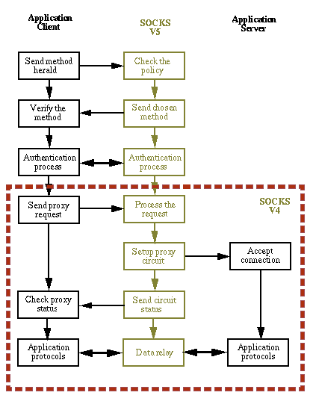
Socks Functionality

Slide 15
GNU ZORP Proxy Firewall Suite
Protocol Analyzing Firewall
core framework allows:
  the administrator to fine tune proxy decisions (Python based)
  fully analyze complex protocols with an application-level gateway:
    SSH with several forwarded TCP connections
    SSL with an embedded POP3 protocol).
    FTP, TTP, finger, whois, SSL .
Usually integrated into the network topology as routers, this means that they have an IP address in all their subnets, and hosts on different subnets use the firewall as their gateway to the outside world.
Proxy based but uses a packet filter to preprocess the packet stream and provide transparency.

Slide 16
How Zorp Works
A TCP session is established in the following way:
client initiates a connection by sending a SYN packet destined to the server
the firewall behaves as a router between the client and the server, receives the SYN packet on one of its interfaces and consults the packet filter
the packet filter rulebase is checked whether the given packet is permitted
if the given connection is to be processed by a proxy, then the packet filter rulebase contains a REDIRECT (ipchains) or TPROXY (iptables) target. Both REDIRECT and TPROXY requires a port parameter which tells the local port of the firewall host where the proxy is listening.
Zorp accepts the connection, checks its own access control rules and starts the appropriate proxy
the proxy connects to the server on its own as needed (the server side connection is not necessarily established immediately)
the proxy mediates protocol requests and responses between the communicating hosts while analyzing the ongoing stream

Slide 17
Best Practices
Use a Real Firewall
Disable Routing
Secure the Base Operating System
  harden the OS
Disable External Access
Disable unneeded Services

Slide 18
Address Conversion Functions and
The Domain Name System
Netprog: DNS and name lookups

Slide 19
Hostnames
IP Addresses are great for computers
  IP address includes information used for routing.
IP addresses are tough for humans to remember.
IP addresses are impossible to guess.
  ever guessed at the name of a WWW site?
Netprog: DNS and name lookups

Slide 20
The Domain Name System
The domain name system is usually used to translate a host name into an IP address .
Domain names comprise a hierarchy so that names are unique, yet easy to remember.
Netprog: DNS and name lookups

Slide 21
DNS Hierarchy
edu
com
org
jp
rpi
albany
Netprog: DNS and name lookups

Slide 22
Host name structure
Each host name is made up of a sequence of labels separated by periods.
  Each label can be up to 63 characters
  The total name can be at most 255 characters.
Examples:
  whitehouse.gov
  barney.the.purple.dinosaur.com
  monica.cs.rpi.edu
Netprog: DNS and name lookups

Slide 23
Domain Name
The domain name for a host is the sequence of labels that lead from the host (leaf node in the naming tree) to the top of the worldwide naming tree.
A domain is a subtree of the worldwide naming tree.
Netprog: DNS and name lookups

Slide 24
Top level domains
edu, gov, com, net, org, mil, …
Countries each have a top level domain (2 letter domain name).
New top level domains include:
  .aero .biz .coop .info .name .pro
Netprog: DNS and name lookups

Slide 25
DNS Organization
Distributed Database
  The organization that owns a domain name is responsible for running a DNS server that can provide the mapping between hostnames within the domain to IP addresses.
  So - some machine run by RPI is responsible for everything within the rpi.edu domain.
Netprog: DNS and name lookups

Slide 26
DNS Distributed Database
There is one primary server for a domain, and typically a number of secondary servers containing replicated databases.
rpi.edu DNS server
rpi.edu
DNS DB
rpi.edu
DNS DB
rpi.edu
DNS DB
rpi.edu
DNS DB
Authoritative
Replicas
Netprog: DNS and name lookups

Slide 27
DNS Clients
A DNS client is called a resolver.
A call to gethostbyname()is handled by a resolver (typically part of the client).
Most Unix workstations have the file /etc/resolv.conf that contains the local domain and the addresses of DNS servers for that domain.
Netprog: DNS and name lookups

Slide 28
/etc/resolv.conf
domain rpi.edu
128.113.1.5
128.113.1.3
Netprog: DNS and name lookups

Slide 29
nslookup
nslookup is an interactive resolver that allows the user to communicate directly with a DNS server.
nslookup is usually available on Unix workstations. (dig and host are also DNS clients).
Netprog: DNS and name lookups

Slide 30
DNS Servers
Servers handle requests for their domain directly.
Servers handle requests for other domains by contacting remote DNS server(s).
Servers cache external mappings.
Netprog: DNS and name lookups

Slide 31
Server - Server Communication
If a server is asked to provide the mapping for a host outside it’s domain (and the mapping is not in the server cache):
  The server finds a nameserver for the target domain.
  The server asks the nameserver to provide the host name to IP translation.
To find the right nameserver, use DNS!
Netprog: DNS and name lookups

Slide 32
DNS Data
DNS databases contain more than just hostname-to-address records:
  Name server records NS
  Hostname aliases CNAME
  Mail Exchangers MX
  Host Information HINFO
Netprog: DNS and name lookups

Slide 33
The Root DNS Server
The root server needs to know the address of 1st (and many 2nd) level domain nameservers.
edu
com
org
jp
rpi
albany
Netprog: DNS and name lookups

Slide 34
Server Operation
If a server has no clue about where to find the address for a hostname, ask the root server.
The root server will tell you what nameserver to contact.
A request may get forwarded a few times.
Netprog: DNS and name lookups

Slide 35
DNS Message Format
HEADER
QUERIES
Response RESOURCE RECORDS
Response AUTHORITY RECORDS
Response ADDITIONAL INFORMATION
Netprog: DNS and name lookups

Slide 36
DNS Message Header
query identifier
flags
# of questions
# of RRs
# of authority RRs
# of additional RRs
16 bit fields
}
Response
Netprog: DNS and name lookups

Slide 37
Message Flags
QR: Query=0, Response=1
AA: Authoritative Answer
TC: response truncated (> 512 bytes)
RD: recursion desired
RA: recursion available
rcode: return code
Netprog: DNS and name lookups

Slide 38
Recursion
A request can indicate that recursion is desired - this tells the server to find out the answer (possibly by contacting other servers).
If recursion is not requested - the response may be a list of other name servers to contact.
Netprog: DNS and name lookups

Slide 39
Question Format
Name: domain name (or IP address)
Query type (A, NS, MX, …)
Query class (1 for IP)
Netprog: DNS and name lookups

Slide 40
Response Resource Record
Domain Name
Response type
Class (IP)
Time to live (in seconds)
Length of resource data
Resource data
Netprog: DNS and name lookups

Slide 41
UDP & TCP
Both UDP and TCP are used:
  TCP for transfers of entire database to secondary servers (replication).
  UDP for lookups
  If more than 512 bytes in response - requestor resubmits request using TCP.
Netprog: DNS and name lookups

Slide 42
Lots more
This is not a complete description !
If interested - look at:
  RFC 1034: DNS concepts and facilities.
  RFC 1035: DNS implementation and protocol specification.
  play with nslookup.
  Look at code for BIND (DNS server code).
Netprog: DNS and name lookups

Slide 43
Name to Address Conversion
There is a library of functions that act as DNS client (resolver).
  you don’t need to write DNS client code to use DNS!
With some OSs you need to explicitly link with the DNS resolver library:
  -lnsl (nsl is “Name Server Library”)
Suns (Solaris) need this!
Netprog: DNS and name lookups

Slide 44
DNS library functions
gethostbyname
gethostbyaddr
gethostbyname2
IPV6!
Netprog: DNS and name lookups

Slide 45
gethostbyname
struct hostent *gethostbyname( const char *hostname);
struct hostent is defined in netdb.h:
#include <netdb.h>
Netprog: DNS and name lookups

Slide 46
struct hostent
struct hostent {
char *h_name;
char **h_aliases;
int h_addrtype;
int h_length;
char **h_addr_list;
};
official name (canonical)
other names
AF_INET or AF_INET6
address length (4 or 16)
array of ptrs to addresses
Netprog: DNS and name lookups

Slide 47
hostent picture
Official Name
h_name
h_aliases
h_addrtype
h_length
h_addr_list
alias 1
alias 2
null
IP address 1
IP address 2
null
Netprog: DNS and name lookups

Slide 48
Which Address?
On success, gethostbyname returns the address of a hostent that has been created.
  has an array of ptrs to IP addresses
  Usually use the first one:
#define h_addr h_addr_list[0]
Netprog: DNS and name lookups

Slide 49
gethostbyname and errors
On error gethostbyname return null.
Gethostbyname sets the global variable h_errno to indicate the exact error:
  HOST_NOT_FOUND
  TRY_AGAIN
  NO_RECOVERY
  NO_DATA
  NO_ADDRESS
All defined in netdb.h
Netprog: DNS and name lookups

Slide 50
Getting at the address: char **h_addr_list;
h = gethostbyname("joe.com");
sockaddr.sin_addr.s_addr =
*(h->h_addr_list[0]);
This won't work!!!!
h_addr_list[0] is a char* !
Netprog: DNS and name lookups

Slide 51
Using memcpy
You can copy the 4 bytes (IPv4) directly:
h = gethostbyname("joe.com");
memcpy(&sockaddr.sin_addr,
h->h_addr_list[0],
sizeof(struct in_addr));
Netprog: DNS and name lookups

Slide 52
Network Byte Order
All the IP addresses returned via the hostent are in network byte order!
Repeat after me:
"Thank you gethostbyname!"
Netprog: DNS and name lookups

Slide 53
gethostbyaddr
struct hostent *gethostbyaddr( const char *addr
size_t len,
int family);
sizeof(struct in_addr)
AF_INET (could be AF_INET6)
Netprog: DNS and name lookups

Slide 54
Some other functions
uname : get hostname of local host
getservbyname : get port number for a named service
getservbyaddr : get name for service associated with a port number
Netprog: DNS and name lookups

Slide 55
Using httpd to setup a www server

Slide 56
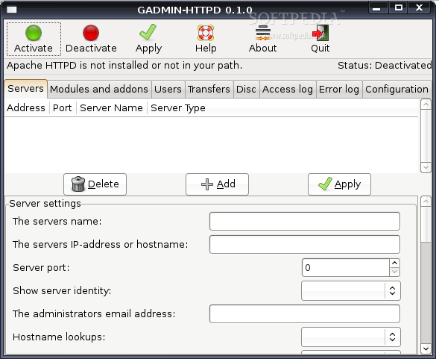

Slide 57
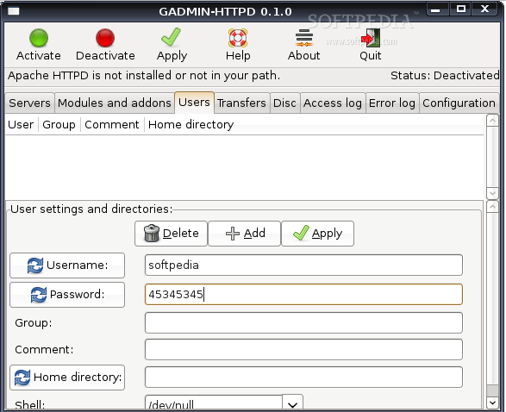

Slide 58
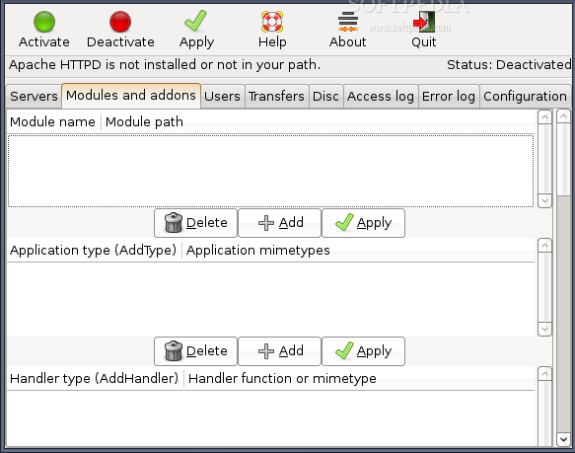

Slide 59
Email Protocols

Slide 60
SMTP Commands
HELO <sp> <domain><crlf>
MAIL <sp>FROM:<reverse path><crlf>
RCPT <sp>TO:<forward path><crlf>
DATA<crlf> terminates with <crlf>.<crlf>
RSET<cflf>
SEND<sp>FROM:<reverse path><crlf>
SOML<sp>FROM:<reverse path><crlf>
SAML<sp>FROM:<reverst path><crlf>
VRFY<sp><string<crlf>
EXPN<sp> <string><crlf>
HELP<sp><string><crlf>
NOOP<crlf>
QUIT<cflf>
TURN<cflf>

Slide 61
SMTP - Commands
HELO
  identifies the client to the server, fully qualified domain name, only sent once per session
MAIL
  initiate a message transfer, fully qualified domain of originator
RCPT
  follows MAIL, identifies an addressee, typically the fully qualified name of the addressee
  for multiple addressees use one RCPT for each addressee
DATA
  send data line by line
  <cr>.<cr> tells server data transfer is over

Slide 62
SMTP - Commands
RSET
  tells server to abort current message and clear all of it buffers
  same state as after HELO
SEND , SOML , SAML
  like MAIL, outdated not used any more
VRFY
  ask server to verify a user name
  server replies positively of it knows user, negatively if not
EXPN
  ask server to confirm mailing list alias
  server reply is multi-line, one per user

Slide 63
SMTP - Commands
HELP
  ask server for help
    by itself get a list of server supported commands
    <string> get help for that command
NOOP
  ask server to respond with a positive reply
QUIT
  tell server that client is ending session
  server replies positively and closes connection
TURN
  reverse roles of client and server
    outdated, rarely used on modern internet

Slide 64
SMTP - Reply codes
211 - System status or help ready
214 - Help message
220 - <domain> Service ready
221 - <domain> Service closing transmission channel
250 - Requested mail action OK, ready
251 - User not local, will forward to <forward path>
354 - Start mail input; end with <crlf>.<crlf>
421 - <domain> Service not avail, closing transmission channel
450 - Requested mail action not taken, mailbox not available
451 - Requested action aborted, local error
452 - Requested action not taken, insufficient storage
500 - Syntax error, command unrecognized
501 - Syntax error in parameters
502 - Command not implemented
503 - Bad sequence of commands
504 - Command Parameter not implemented

Slide 65
Reply codes (more)
550 - Requested action not taken, mailbox unavailable
551 - User not local, please try <forward path>
552 - Requested mail action not taken; exceeded storage allocation
553 - Requested action not taken, mailbox name not allowed
554 - Transaction failed

Slide 66
Post Office Protocol (POP3)
Used in conjunction with anSMTP Host
  SMTP Host sends and receives e-mail for remote users, POP allows users to retreive their mail from the host.
  SMTP stores mail for unconnected hosts
RFC 1730
TCP Port 110

Slide 67
POP3
protocol is relatively simple
  connect to port 110 of remote host
    read back a response check for OK or ERR
    over and over again
  close the connection

Slide 68
POP3 - State Machine
Commands
Auth
Auth
Transaction
Update
USER
PASS
QUIT

Slide 69
POP3 - Commands
Commands
  USER name
    terminate with <crlf>
    identifies the user/mail drop name
  PASS string
    user password
    usually the same as the user’s logon password
  STAT
    request number of messages on server and size of mail drop

Slide 70
POP3 - Commands
  LIST
    return a list <crlf> of all msgs on server
      format msg size
  LIST [msg_no]
    request size of msg_no
      format msg_no size
  RETR msg_no
    return the message identified by msg_no

Slide 71
POP3 - Commands
  DELE msg_no
    delete msg_no from server
    happens in UPDATE State
  NOOP
    nothing except a positive reply from server
  RSET
    reset all deletions pending on server
  QUIT
    quit session, UPDATE, enter AUTH1 State

Slide 72
IMAP
Developed after POP and attempts to fix POP deficiencies
  allows keeping all mail on the server
  allows mail categorization via folder metaphor
  mail is easily flagged (answered, draft, deleted, seen, recent); this isn’t the same on all servers
  provides for multiple connections to the server

Slide 73
IMAP - process
make connection
send user credentials (userid and password)
  repeat until done
    send a command
    read response
  disconnect

Slide 74
IMAP Command
tag command argurment(s)
  tag, either a “.” or a text string that can be sequentialized (a0001, a0002, a0003….); if only a single connection use “.” , if multiple connections use text string (this allows matching commands with responses).

Slide 75
IMAP - Commands
login
list
status
examine
select
create, delete, rename
fetch
store
close
expunge
copy
idle
lsub, subscribe, unsubscribe
logout
capability, getquotaroot, getacl

Slide 76
IMAP - Commands
login
  userid@address
  password
  example
  . login steflik@binghamton.edu xyz123
  (if not using ssl this goes as plain text just like pop)
  response – server should acknowledge with OK

Slide 77
IMAP Commands
logout command
  no arguments
The command is sent to the server, the server replys with a BYE message followed by an OK message and closes the connection.

Slide 78
IMAP - Commands
list
  retrieves a list of the mailboxes/folders
  argruments :
  reference name:
  mailbox name w/possible wildcards
  returns an untagged list of the mailboxes/folders along with a separator char and an indication of hierarchy followed by a tagged OK
  for details refer to rfc 1730

Slide 79
IMAP Commands
status command
  arguments:
  mailbox/folder
  (space delimited list of flags)
  return info you asked for; untagged list
  ex: a006 status inbox (messages uidnext)
  * STATUS “inbox” (MESSAGES 404 UIDNEXT 1001)
  a006 OK Success

Slide 80
IMAP Commands
examine & select commands
  arguments:
  mailbox/folder
  returns: Flags information, how many of messages each flag type are in the folder; then allows access to the messages in the folder
  examine allows read-only
  select allows read-write access

Slide 81
IMAP Commands
create, delet and rename commands
create newfoldernane – creates a new folder
delete foldername – deletes the named folder
rename oldname newname – renames the folder
foldernames must be fully qualified using the separator char from the info returned by the list command

Slide 82
IMAP Commands
fetch command – used to actually access e-mails
arguments:
message number or range of numbers
( 1 , 1:2 , 1:last)
what it is you want to retrieve
( fast, all, text, rfc822.header….see rfc)

Slide 83
IMAP Commands
store – lets you set the flags for messages
arguments:
message number/range
flags to be set
(\Answered \Flagged \Draft \Deleted
\Seen hasatt Junk )

Slide 84
IMAP Commands
close & expunge commands – used to permanently delete a message(s) in the current folder that has the \Deleted flag set.

Slide 85
IMAP Commands
copy command – copy a message or range of messages to another folder then delete the originals
arguments:
message number or range
target folder
ex: copy 1:3 linux.debian

Slide 86
IMAP Commands
idle command – lets you monitor a folder until something new is added to it

Slide 87
IMAP Commands
capability command – untagged list of the servers capabilities
getquotaroot – returns the amount of space you are using and how much is available
  ex: getquitaroot inbox
getacl command – returns the access control list for the specified folder (l,r,s,w,I,p,c,d,a)

Slide 88
MIME
Important RFCs
  RFC-822 Standard for the format for ARPA Internet test messages
  RFC-2045 MIME Part 1: Format of Internet Message Bodies
  RFC-2046 MIME Part 2: Media Types
  RFC-2047 MIME Part 3: Message Header Extensions
  RFC-2048 MIME Part 4: Registration Procedure
  RFC-2049 MIME Part 5: Conformance Criteria

Slide 89
MIME – What is it?
MIME refers to an official Internet standard that specifies how messages must be formatted so that they can be exchanged between different email systems.
MIME permits the inclusion of virtually any type of file or document in an email message.
Specifically, MIME messages can contain
  text
  images
  audio
  video
  application-specific data.
    spreadsheets
    word processing documets

Slide 90
MIME - Features
Support of character sets other than ASCII
Content type labeling System
Support of non-text content in e-mail messages
Support for compound documents

Slide 91
MIME - Non-ASCII Character support
Message header
  content-type field
    put in the header by the client program creating the e-mail for use by the client program used to display the received message
    charset= optional parameter
      if absent ASCII is assumed
Content-Type: text/plain; charset="ISO-8859-1"
  ISO-8859-1 extends the basic character set of ASCII to include many of the accented characters used in languages such as Spanish, French, and German.
  US-ASCII is the standard character set used in the US

Slide 92
MIME - Content Labeling
a set of registered MIME Types that map to specific file types
  MIME Types consist of :
    a primary type
    a sub type separated by a / ( as text/html)
Common Mime Types:
FileExtension MIME Type Description
.txt text/plain Plain text
.htm text/html Styled text in HTML format
.jpg image/jpeg Picture in JPEG format
.gif image/gif Picture in GIF format
.wav audio/x-wave Sound in WAVE format
.mp3 audio/mpeg Music in MP3 format
.mpg video/mpeg Video in MPEG format
.zip application/zip Compressed file in PK-ZIP format

Slide 93
Non-text Content
To be sent through the e-mail system non-textual content must be converted (encoded) to ASCII for transmission and unencode back to its original format for display upon receipt.
  originally done via uuencode
  MIME uses base 64 encoding (RFC 2045)
    binary to text encoding scheme
    targets A-Z, a-z,0-9, +,/
    scheme:
      take three byte of data, put into a 24 bit buffer
      extract 4 six bit values
      use each value as an index into:
        ABCDEFGHIJKLMNOPQRSTUVWXYZabcdefghijklmnopqrstuvwxyz0123456789+/
      this yields 4 ASCII characters

Slide 94
MIME - base64 encoding example
Man is distinguished, not only by his reason, but by this singular passion from other animals, which is a lust of the mind, that by a perseverance of delight in the continued and indefatigable generation of knowledge, exceeds the short vehemence of any carnal pleasure.
base64 encoded:
TWFuIGlzIGRpc3Rpbmd1aXNoZWQsIG5vdCBvbmx5IGJ5IGhpcyByZWFzb24sIGJ1dCBieSB0 aGlzIHNpbmd1bGFyIHBhc3Npb24gZnJvbSBvdGhlciBhbmltYWxzLCB3aGljaCBpcyBhIGx1 c3Qgb2YgdGhlIG1pbmQsIHRoYXQgYnkgYSBwZXJzZXZlcmFuY2Ugb2YgZGVsaWdodCBpbiB0 aGUgY29udGludWVkIGFuZCBpbmRlZmF0aWdhYmxlIGdlbmVyYXRpb24gb2Yga25vd2xlZGdl LCBleGNlZWRzIHRoZSBzaG9ydCB2ZWhlbWVuY2Ugb2YgYW55IGNhcm5hbCBwbGVhc3VyZS4=

Slide 95
MIME - Multipart Messages
use content-type = multipart/sub type
  sub types :
    related
    mixed
see examples at http://www.hunnysoft.com/mime/samples/index.htm

Slide 96
Security

Slide 97
There are four basic elements in security:
• Privacy, restriction of access.
• Authentication: verification of identity.
• Trust: trusting the source.
• Integrity, protection against corruption or loss (redundancy).

Slide 98
Security Policy
A network security policy is a generic document that outlines rules for computer network access, determines how policies are enforced and lays out some of the basic architecture of the company security/ network security environment - wiki
How secure must we be
• From outside the organization?
• From inside the organization (different host)?
• From inside the organization (same host)?
• Against the interruption of services?
• From user error?

Slide 99
Principle 44 (Work defensively) Expect the worst, do your best, preferably in advance of a problem.
Principle 45 (Network Security) Extremely sensitive data should not be placed on a computer which is attached in any way to a public network
What resources are we trying to protect?
Who are we trying to protect them from?

Slide 100
What is the Intrusion Detection
Intrusions are the activities that violate the security policy of system.
Intrusion Detection is the process used to identify intrusions.

Slide 101
Types of Intrusion Detection System(1)
Based on the sources of the audit information used by each IDS, the IDSs may be classified into
  Host-base IDSs
  Distributed IDSs
  Network-based IDSs

Slide 102
Types of Intrusion Detection System(2)
Host-based IDSs
  Get audit data from host audit trails.
  Detect attacks against a single host
Distributed IDSs
  Gather audit data from multiple host and possibly the network that connects the hosts
  Detect attacks involving multiple hosts
Network-Based IDSs
  Use network traffic as the audit data source, relieving the burden on the hosts that usually provide normal computing services
  Detect attacks from network.

Slide 103
What is a Firewall?
A choke point of control and monitoring
Interconnects networks with differing trust
Imposes restrictions on network services
  only authorized traffic is allowed
Auditing and controlling access
  can implement alarms for abnormal behavior
Itself immune to penetration
Provides perimeter defence

Slide 104
Methods for detection/protection/defense:
  Firewall: The Traffic cop
  IDS: detection and alert
These have shortcomings:
  Internal threats
  Virus laden programs
  False Positives and False negatives
Honeynet: An additional layer
Any security resource who’s value lies in being probed, attacked, or compromised
A resource that expects no data, so any traffic to or from it is most likely unauthorized activity

Slide 105
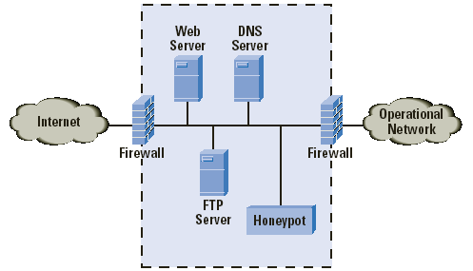

Slide 106
What is VPN?
Virtual Private Network is a type of private network that uses public telecommunication, such as the Internet, instead of leased lines to communicate.
Became popular as more employees worked in remote locations.
Terminologies to understand how VPNs work.

Slide 107
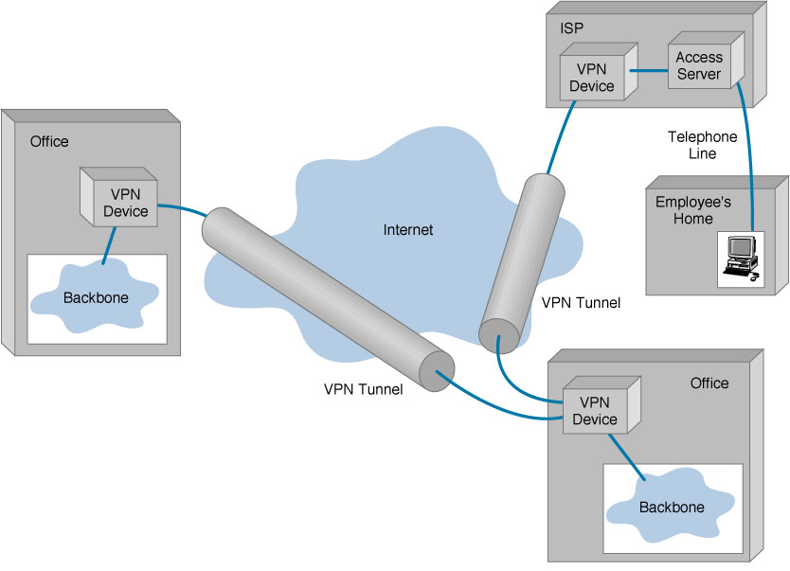
Basic Architecture

Slide 108
Analytical System Administration

Slide 109
Faults
The IEEE classification of software anomalies is
• Operating system crash.
• Program hang-up.
• Program crash.
• Input problem.
• Output problem.
• Failed required performance.
• Perceived total failure.
• System error message.
• Service degraded.
• Wrong output.
• No output

Slide 110

Reliability
average (mean) time before failure
Rate of service (delivery) = change in information/rate of failure

Slide 111
Metrics for evaluating network performance
Total number of packets
Amount of IP fragmentation
Density of broadcast messages
Number of collisions
Number of sockets (TCP) in and out
Number of malformed packets
Latency of services

Slide 112
Metrics for evaluating system performance
Disk usage in bytes
Disk operations per second
Paging (out) rate (free memory and thrashing):
Number of processes & privileged processes
Maximum percentage CPU used in processes
Number of users logged on
Average time spent logged on per user
Load average
Latency of services

